Slide 1
Recommender Systems

Slide 2
Recommender systems
Recommender Systems are machine learning systems that help users discover new product and services. Every time you shop online, recommendation system is guiding towards the most likely product the user is going to buy.

Slide 3
Recommender systems
Recommendation system in today’s world is an essential feature as users are often overwhelmed by choice and recommendation system help users quickly find the product they love.
It leads to more sales as well as make users happier. These systems make companies dollars as recommending a product to a user might yield a sale or make the user think about whether to purchase a product or not.
It’s like a salesman recommending product but a virtual one without any human curation but a better curation based on your history.

Slide 4
Content based filtering
Content-based filtering methods are based on a description of the item and a profile of the user’s preferences.
In a content-based recommender system, keywords are used to describe the items and a user profile is built to indicate the type of item this user likes. In other words, these algorithms try to recommend items that are similar to those that a user liked in the past (or is examining in the present).
In particular, various candidate items are compared with items previously rated by the user and the best-matching items are recommended. This approach has its roots in information retrieval and information filtering research.

Slide 5
Content based filtering
To abstract the features of the items in the system, an item presentation algorithm is applied. A widely used algorithm is the tf-idf representation (also called vector space representation) To create a user profile, the system mostly focuses on two types of information:
1. A model of the user's preference.
2. A history of the user's interaction with the recommender system.

Slide 6
Collaborative filtering
collaborative filtering is a method of making automatic predictions (filtering) about the interests of a user by collecting preferences or taste information from many users (collaborating).
The underlying assumption of the collaborative filtering approach is that if a person A has the same opinion as a person B on an issue, A is more likely to have B's opinion on a different issue than that of a randomly chosen person.

Slide 7
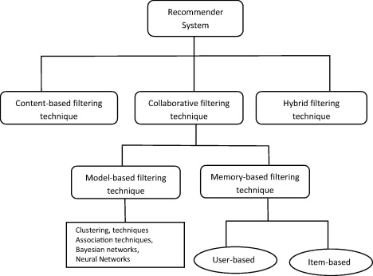

Slide 8
https://towardsdatascience.com/how-to-build-from-scratch-a-content-based-movie-recommender-with-natural-language-processing-25ad400eb243

Slide 9
https://www.google.com/search?biw=1527&bih=809&tbm=isch&sa=1&ei=EBuXXI2bI430rAGqj4O4DA&q=content+based+filtering&oq=content+based+filtering&gs_l=img.3..0l3j0i24l7.69966.71928..72269...0.0..0.128.1562.0j13......1....1..gws-wiz-img.......0i7i30j0i7i5i30j0i5i30j0i8i7i30.BQk6DBOHRkQ#imgrc=y6iBNq3WM_fVvM:

